Slide 1

Forecasting Model on Delhi Air Pollution ( PM2.5 ) Final Presentation – 7th June 2020
Team – 2
Karthik N R
Arjun C
JAYASIMHA
KIRAN
Niranjan Sapkal
Sanjivani Panse
Mentor
Vinod
Rajshekhar

Slide 2
Project Architecture / Project Flow
Sr. No. | Particular
1 | Preface ( Understanding the Business Problem )
2 | Air Quality Index (AQI) and PM2.5
3 | Exploratory Data Analysis
4 | Data Imputation
5 | Model Building and Testing
6 | Model Deployment
7 | Project Submission

Slide 3
Preface

Slide 4
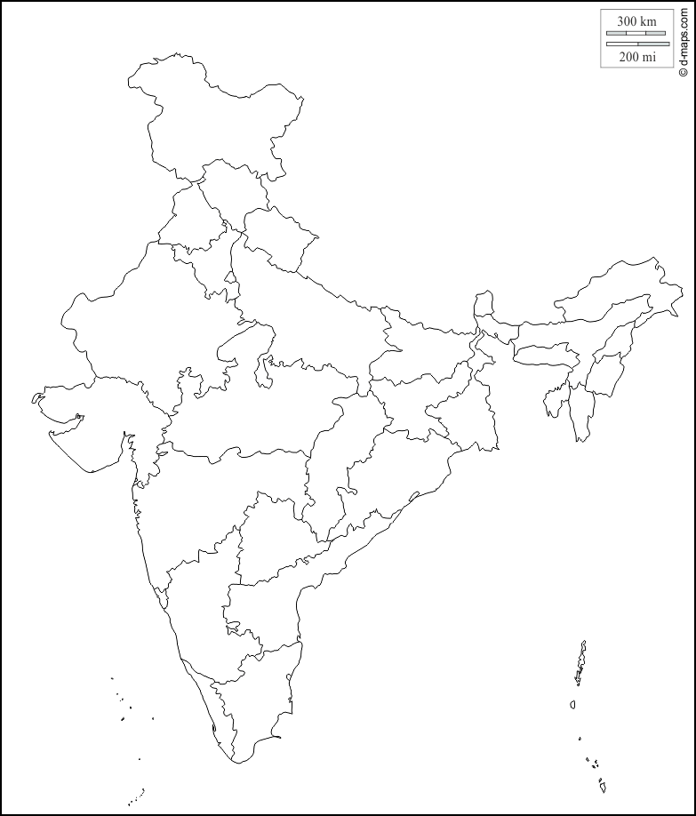
Preface
Business Objective
Regional Scope
Particulate matter (PM ) has been recorded in Delhi to understand the air quality on an hourly basis for 4 months. Our objective is to forecast the data available.
Delhi
Data Set Details
Data Set is provided for 4 months on hourly basis. Starting from 2018-01-01 00:00:00 to 2018-04-20 00:00:00
Data Set Contains Two Variables
Y = pm25
X = date
Total Number of Observations : 2374
INDIA

Slide 5
Air Quality Index (AQI) and PM2.5
AQI is used by government agencies to communicate to the public how polluted the air currently is or how polluted it is forecast to become
Public health risks increase as the AQI rises. Air quality measurement are commonly reported in terms of micrograms per cubic meter (µg/m3) parts per million (ppm) or parts per billion (ppb)
AQI converts the measured pollutant concentrations in a community’s air to a number on a scale of 0 to 500 and above
PM2.5 refers to atmospheric particulate matter (PM) that have a diameter of less than 2.5 micrometers, which is about 3% the diameter of a human hair
PM2.5 can come from various sources. They include power plants, motor vehicles, airplanes, residential wood burning, forest fires, agricultural burning, volcanic eruptions and dust storms. Some are emitted directly into the air, while others are formed when gases and particles interact with one another in the atmosphere
Studies have found a close link between exposure to fine particles and premature death from heart and lung disease. There are various studies published by associations such as American Heart Association, Journal of the American Medical Association, etc. on adverse effect on PM2.5 on human health.

Slide 6
Exploratory Data Analysis

Slide 7
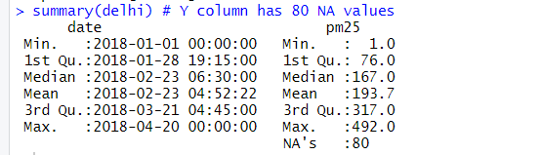
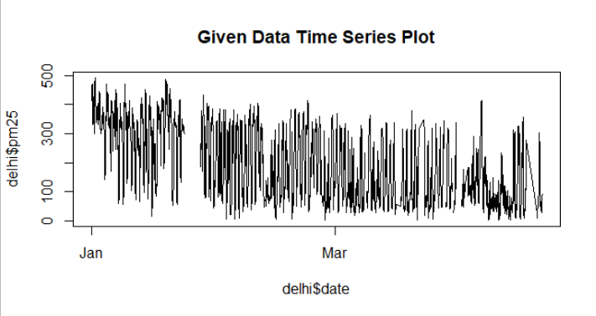
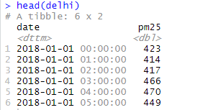
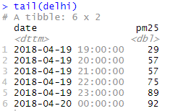
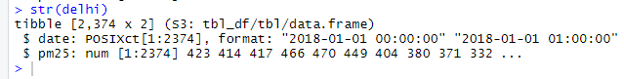
Exploratory Data Analysis
Importing the Given Data Set
Summary Given Data Set
Given data set is from April to January on hourly basis, to perform the analysis and modelling we have to reverse the order of the date and pm25 from January to April
Y variable is having data type character, converted it into numeric because it is a continuous data
Head and Tail of the Given Data Set
Given Data Set - Plot
Structure of the Given Data Set

Slide 8
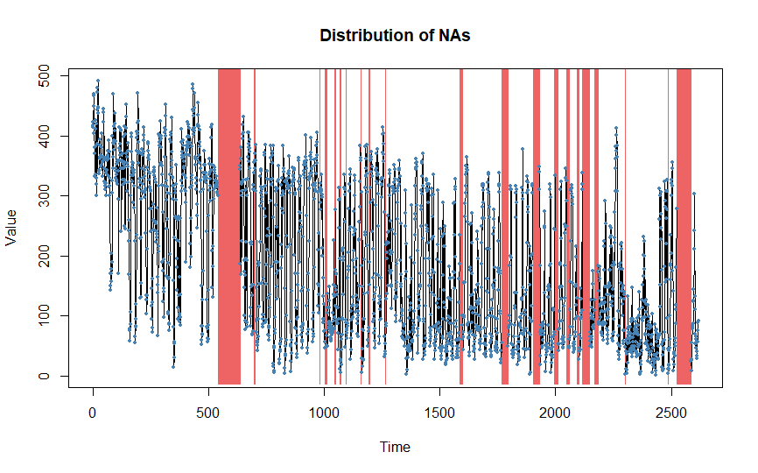
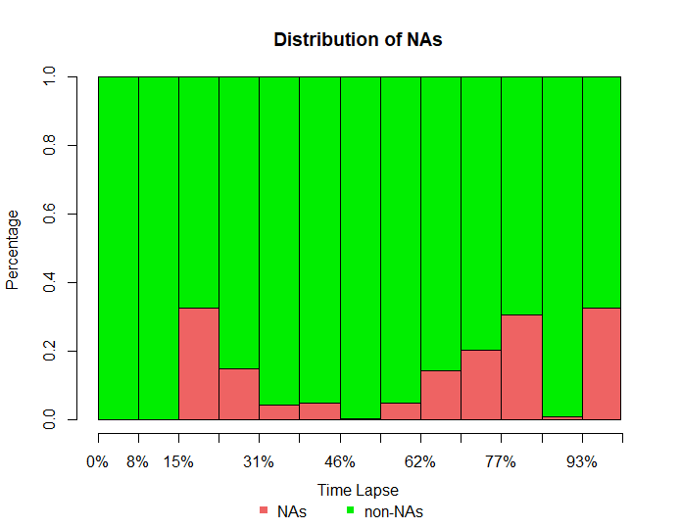
Exploratory Data Analysis
NA Values Analysis
Total percentage of missing values is 12.34%
3.06% data is missing from PM25 column
9.29% data is missing from date column
There are total 323 NA values (80 in PM25 column and 243 in Date Column)
"Overview NA series"
" 1 NA in a row: 7 times"
" 2 NA in a row: 4 times"
" 4 NA in a row: 1 times"
" 7 NA in a row: 1 times"
" 8 NA in a row: 1 times"
" 9 NA in a row: 1 times"
" 10 NA in a row: 1 times"
" 13 NA in a row: 1 times"
" 15 NA in a row: 1 times"
" 27 NA in a row: 1 times"
" 29 NA in a row: 1 times"
" 30 NA in a row: 1 times"
" 62 NA in a row: 1 times"
" 94 NA in a row: 1 times“
94 NA in a row
62 NA in a row

Slide 9
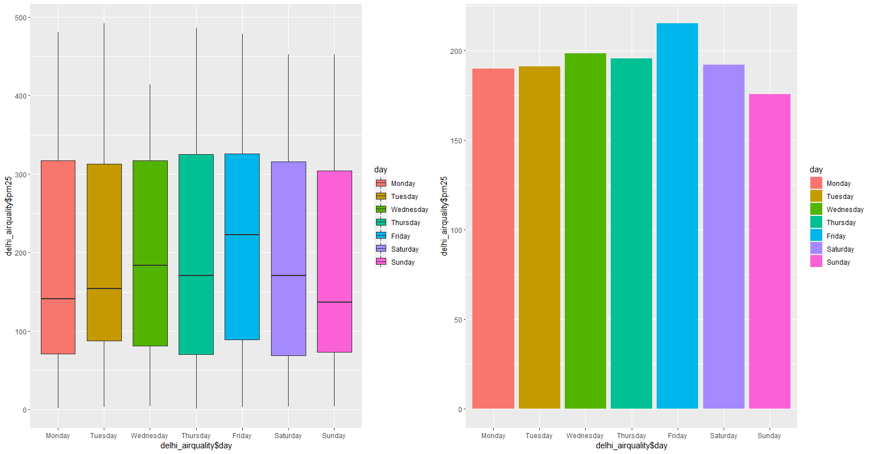
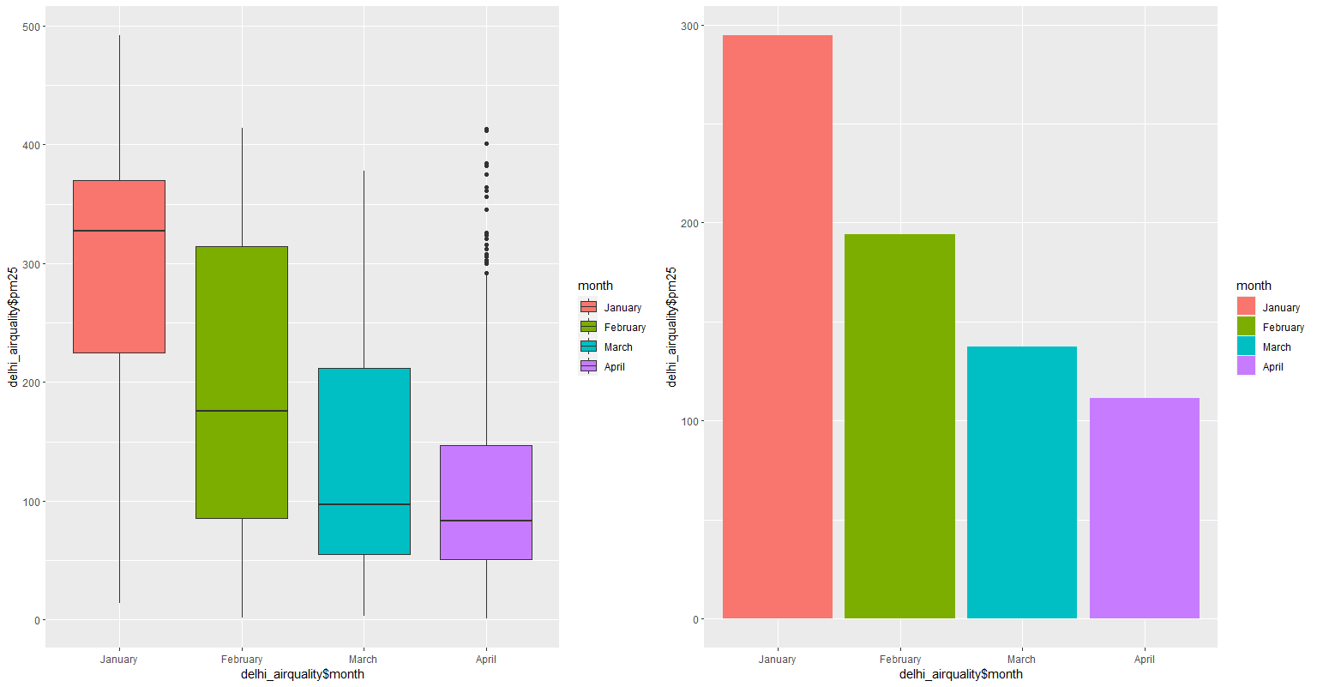
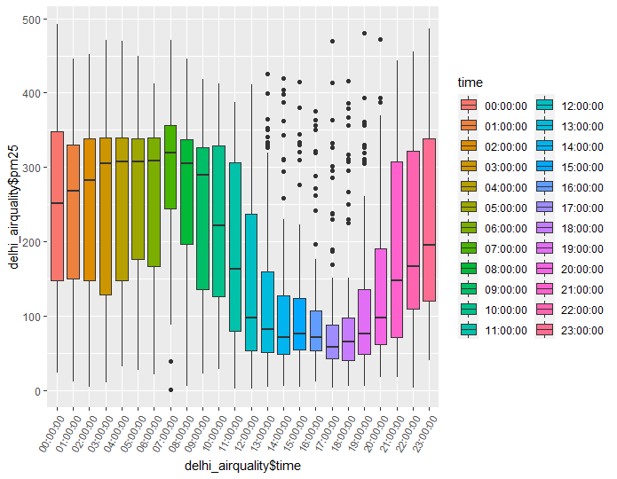
Hourly, Daily and Monthly Data Analysis
Hourly Data Analysis
Daily Data Analysis
Monthly Data Analysis
Outlier Observations
Outlier Observations
Mean PM2.5 level is on higher side from 00 AM to 11-12 PM
PM2.5 level starts to decline after 12 and again starts to rise from 6-7 PM
Most of the outliers observation are observed from 1 PM to 8 PM
Average PM2.5 level is more on Friday than other weekdays-considering 4 months data
Lowest is observed on Sunday followed by Monday and Tuesday
Mean PM2.5 level is on higher side in the month of January
PM2.5 level is decreasing month by month and lowest mean PM2.5 was recorded for the month of April for Given Data
Outlier observations were observed in the month of April

Slide 10
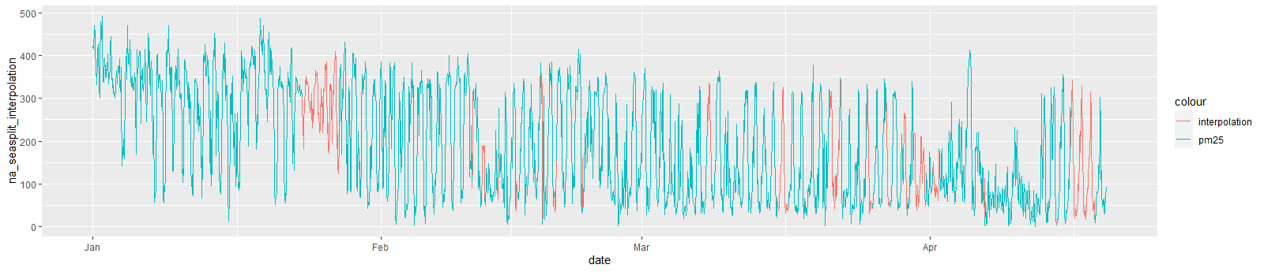
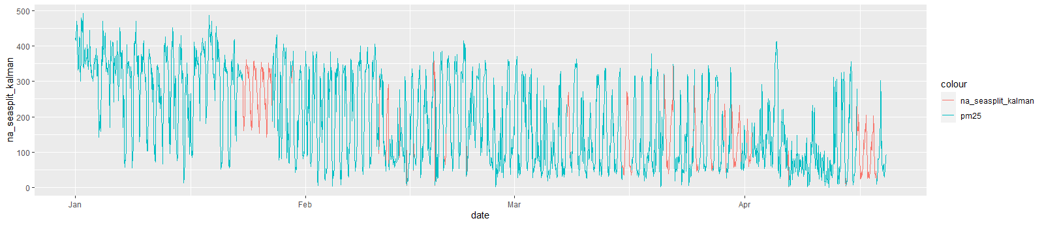
Data Imputation
We have used Seasonally Splitted Missing Value Imputation (na_seasplit) from imputeTS library with Interpolation, Kalman, locf (Last Observation Carried Forward) and ma (Moving Average) algorithms
Interpolation
Kalman

Slide 11
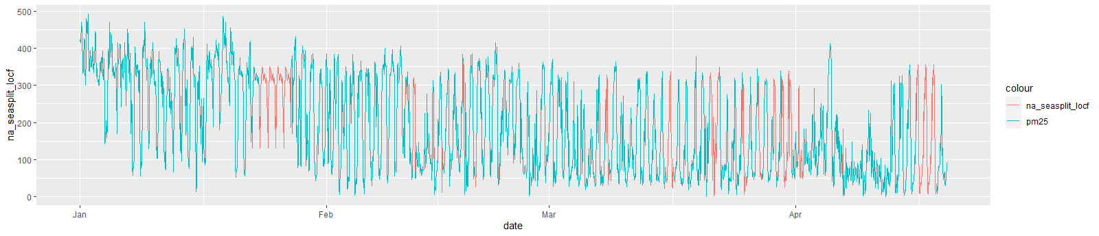
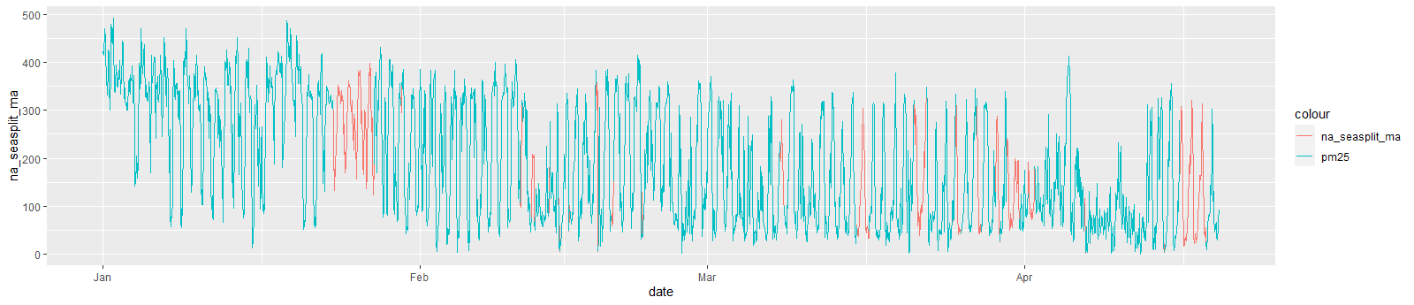
Continued….
locf (Last Observation Carried Forward)
ma (Moving Average)

Slide 12
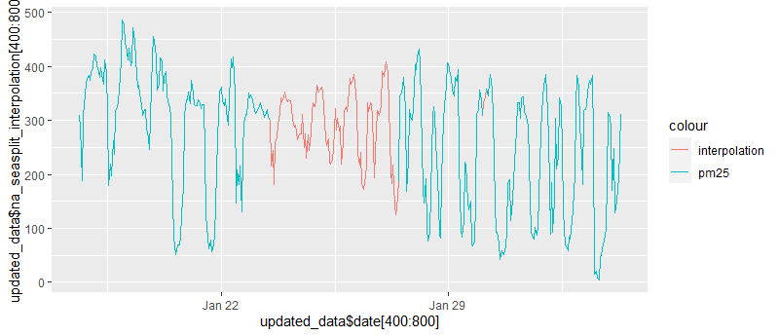
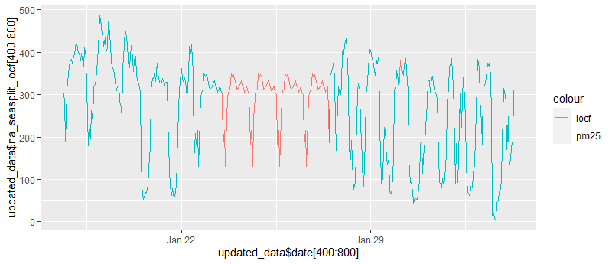
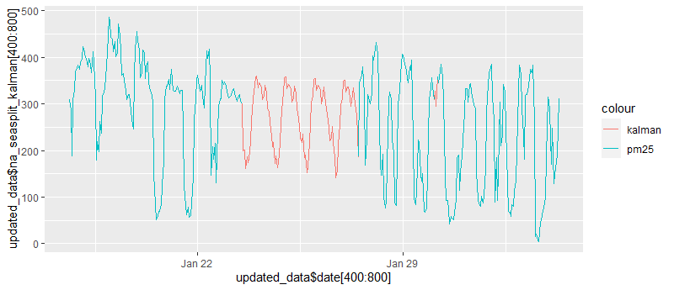
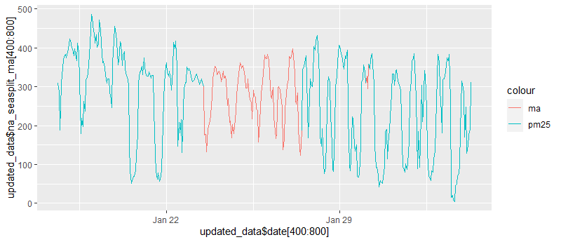
Close Look at 94 NA Interpreted in a Row at the Start of the Series
Interpolation
locf (Last Observation Carried Forward)
Kalman
ma (Moving Average)

Slide 13
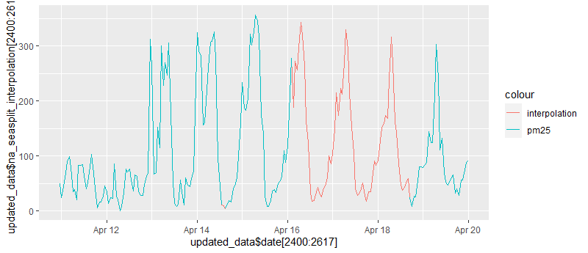
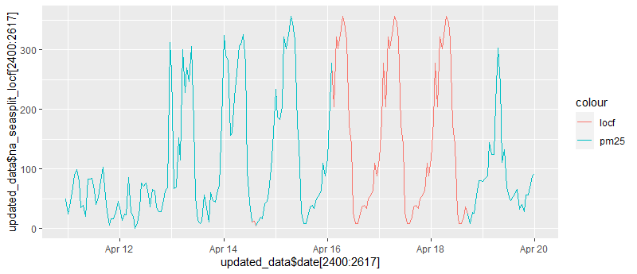
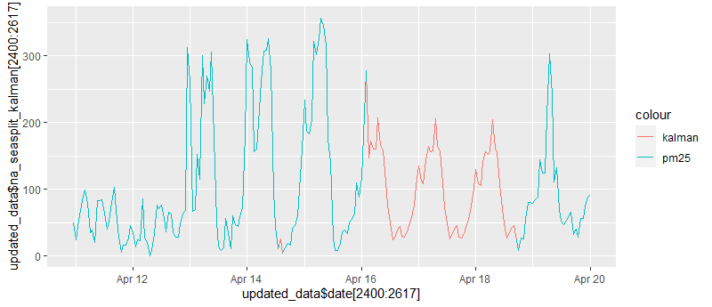
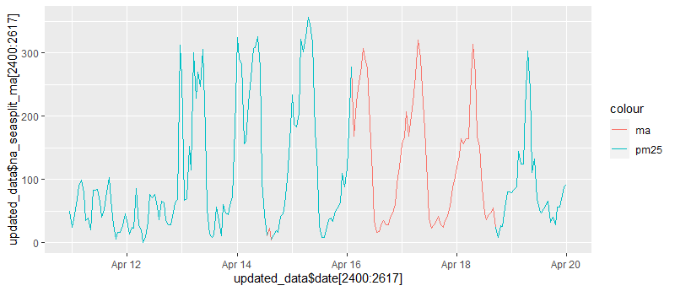
Close Look at 62 NA Interpreted in a Row at the End of the Series
Interpolation
locf (Last Observation Carried Forward)
Kalman
ma (Moving Average)
It has been observed than moving average algorithm is giving the closest NA prediction pattern to the actual data
Selecting moving average as data imputation technique and building model on imputed data

Slide 14
Model Building and Testing

Slide 15
Model Building
Full Data Set - 2617 Observations
Train Data Set
1570 Observations
Test Data Set
1047 Observations
Sr. No. | Model Name | Test Data RMSE 1047 Observations | Train Data RMSE 1570 Observations | Full Data Train RMSE 2617 Observations
1 | STLF | 70.08 | 41.66 | 41.85
2 | ARIMA | 73.63 | 49.79 | 45.52
3 | TBATS | 75.71 | 49.00 | 46.39
4 | EXPONENTIAL SMOOTHING | 76.44 | 82.06 | 49.34
5 | AUTO ARIMA | 78.00 | 52.34 | 49.55

Slide 16
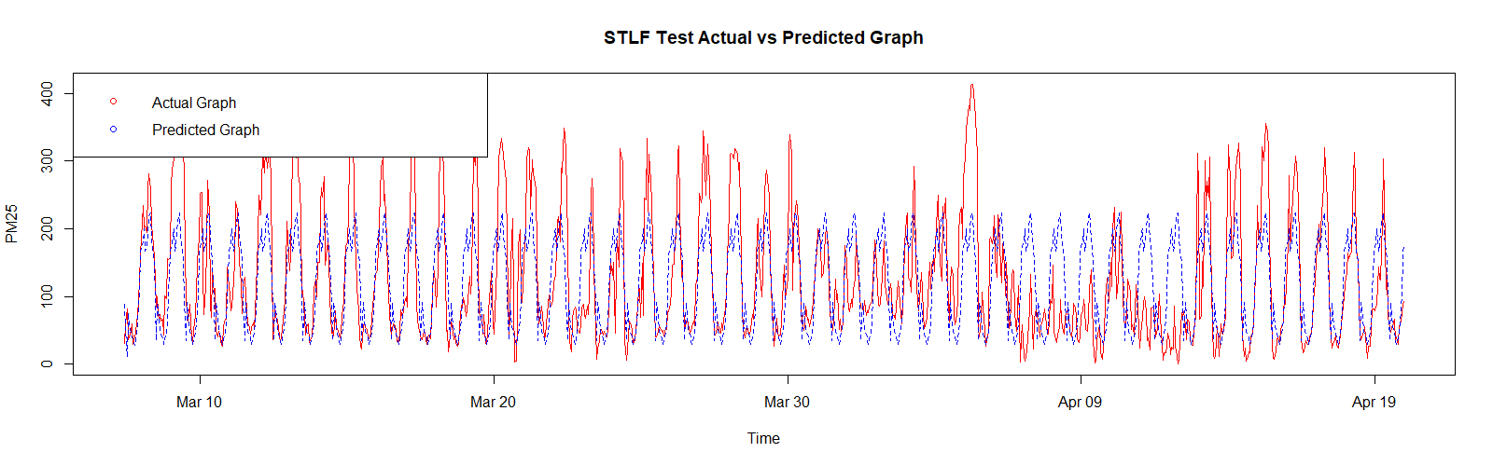
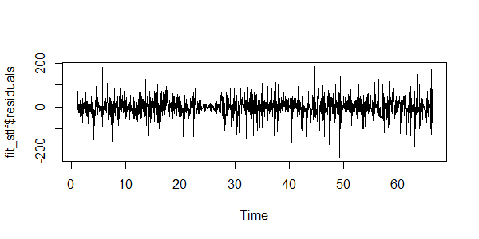
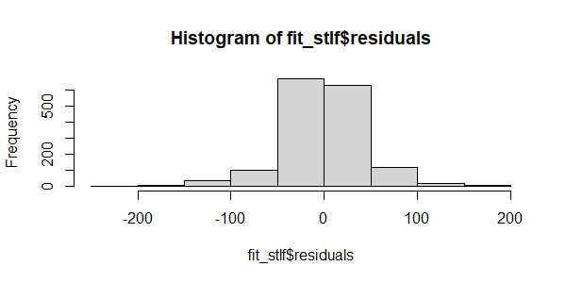
STLF Model Test Actual vs Prediction Graph
Checking the Residual Plot of STLF Model
STLF Model
Residual Skewness: -0.28

Slide 17
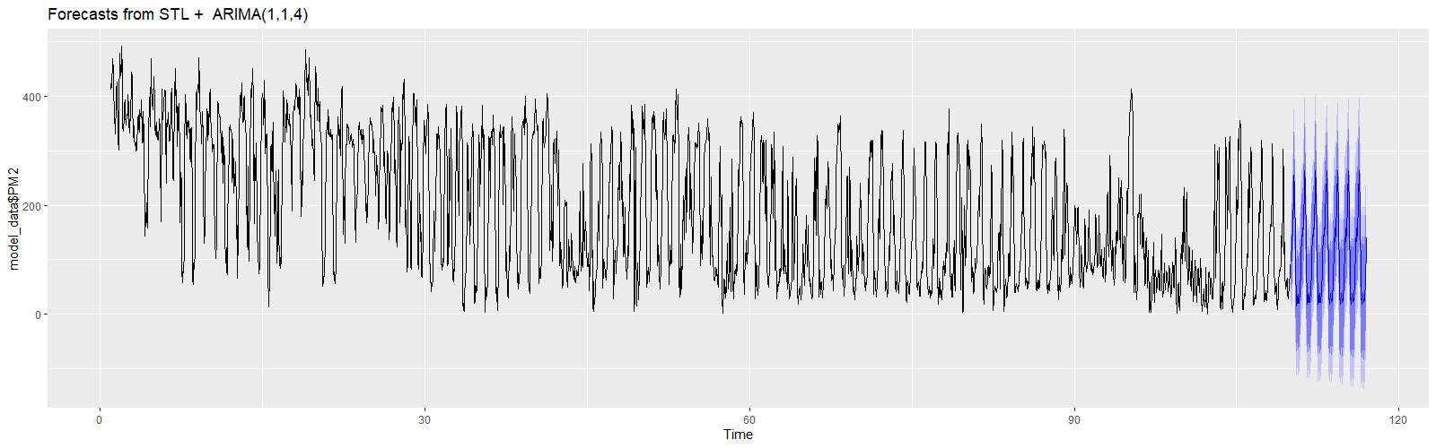
Final Model for Forecasting
STLF Model
Final_Model <- stlf(train$PM25,method = "arima", h = 336)
Forecasting with ARIMA Model for Next One Week (336 Observations)

Slide 18
Model Deployment

Slide 19
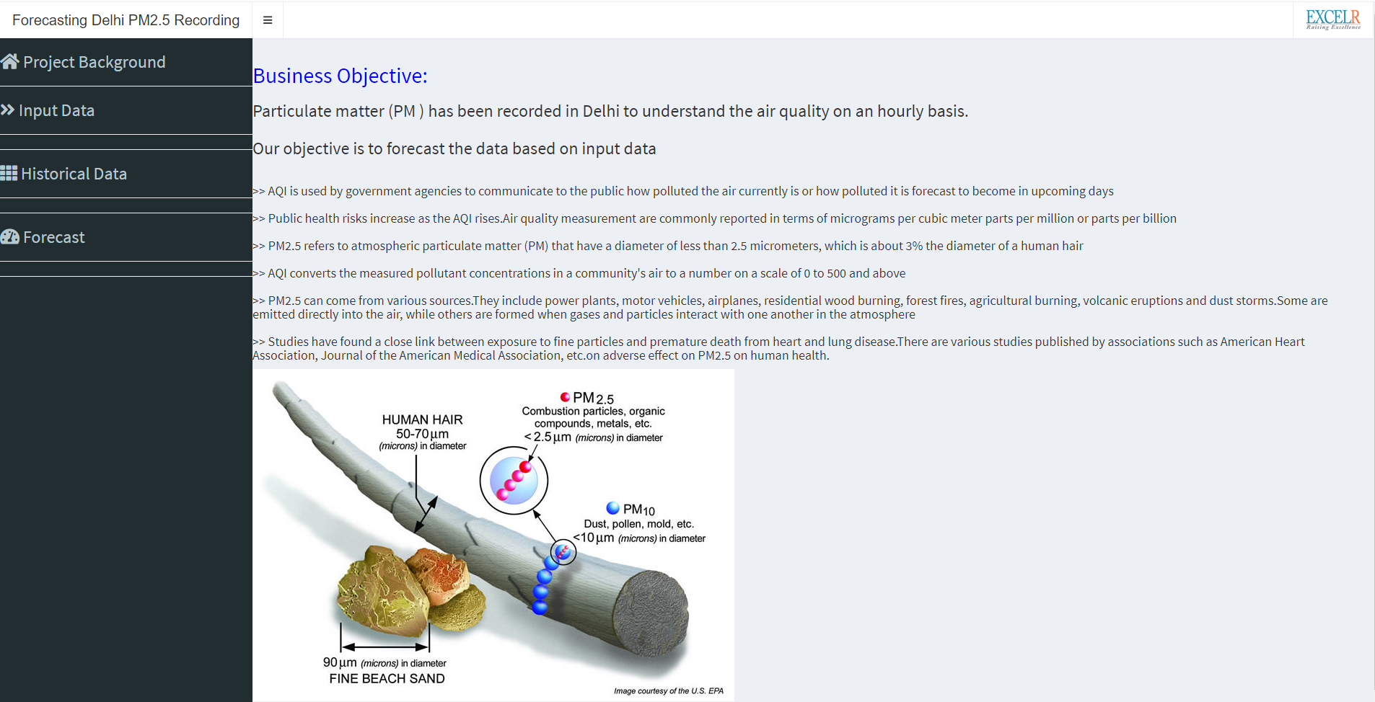
Model Deployment – Project Background

Slide 20
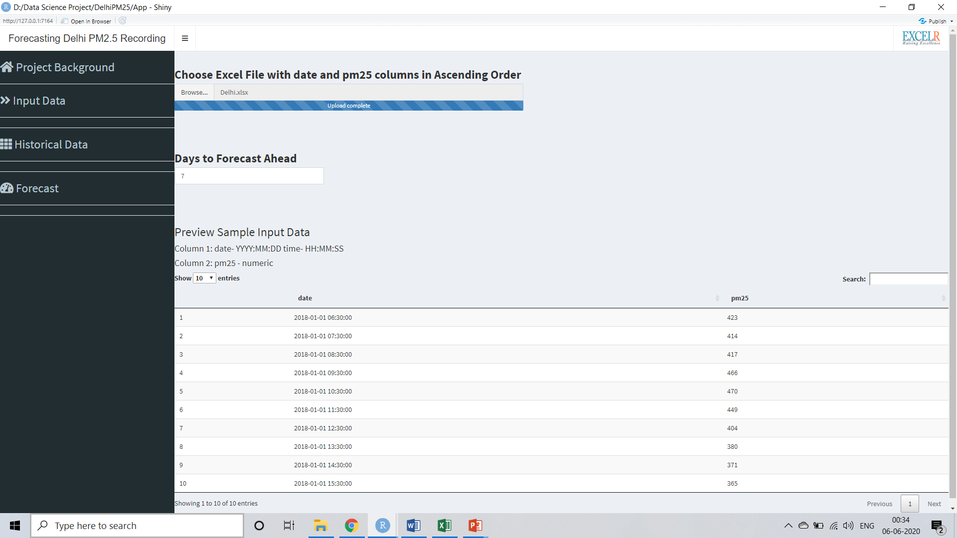
Model Deployment – Input Data

Slide 21
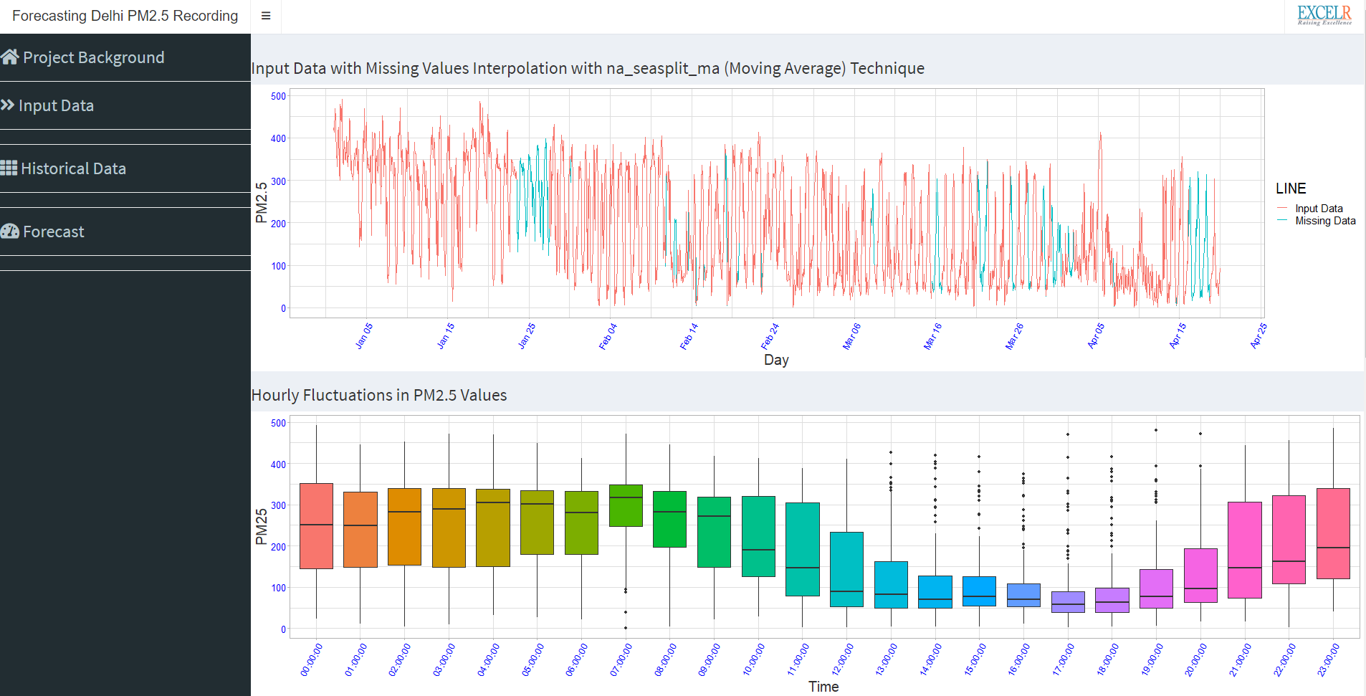
Model Deployment – Historical Data

Slide 22
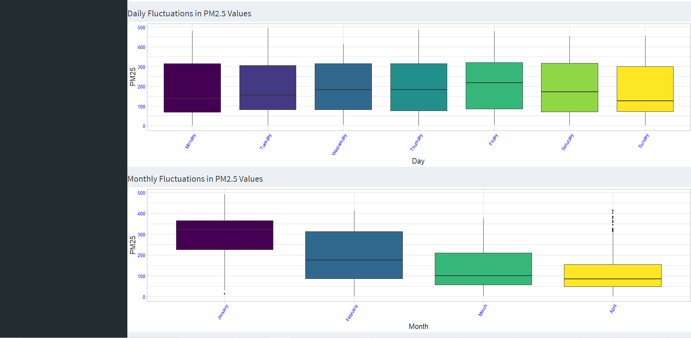
Model Deployment – Historical Data

Slide 23

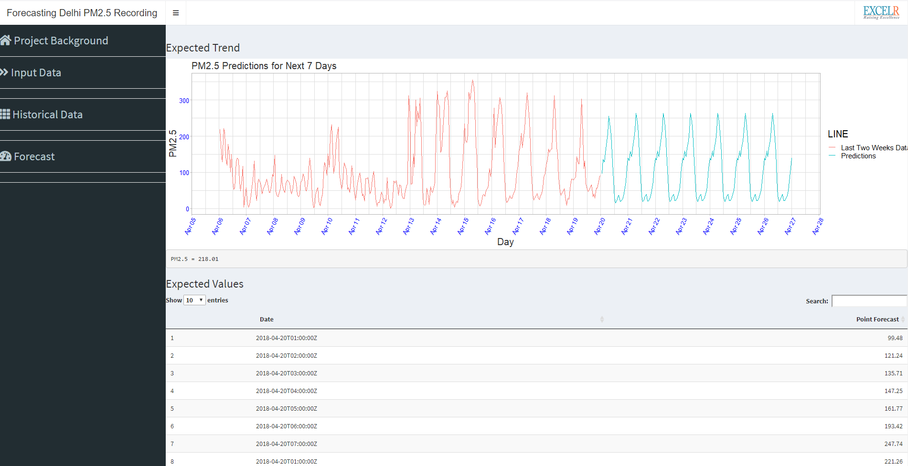
Model Deployment – Forecast
https://niranjan-sapkal.shinyapps.io/PM25/
Click To Go Live

Slide 24
Challenges Faced During Project

Slide 25
Challenges Faced During The Project
Understanding the domain knowledge regarding air pollution and its measuring parameters
Missing values in date and pm25 column
Finding out the most appropriate method for replacing missing values
As we have seen in the EDA process, there are 62 missing values in a row at the end of the series. Also we have consistent lower PM2.5 values in the month of April 2018Both the above data sets are part of our initial test data set (2000 train and 617 Test)
Choosing the final model as RMSE values of top 4 models are very close to each other
Solution
Did through secondary research on air pollution and its measuring parameters
Used pad from padr library and full_join function from dplyr library to find out all 323 missing values
We have tried nterpolation, Kalman, locf (Last Observation Carried Forward) and ma (Moving Average) algorithms for missing value interpolation. To choose the most appropriate one, we have checked the how each algorithm is predicting 94 missing values in a row at the start of the series and 62 missing values in a row at the end of the series
To overcome this we have included some data from March 2018 month in to test data set by splitting the series as 60% train and 40% test data set

Slide 26


